Slide 1
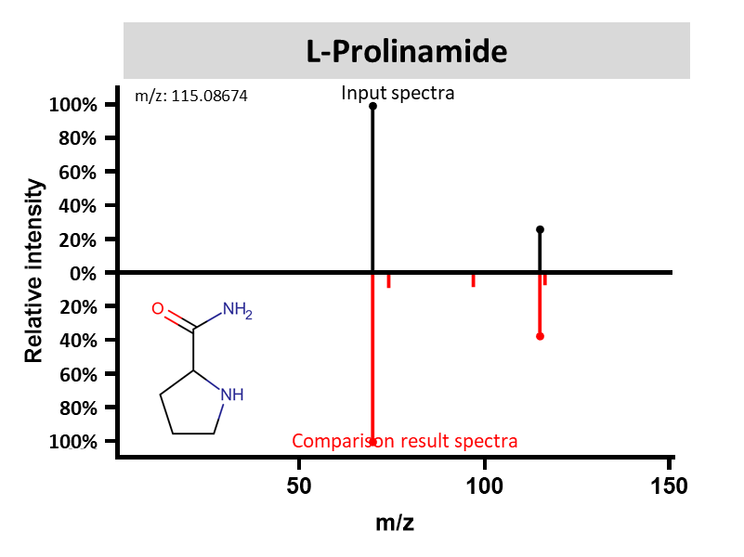
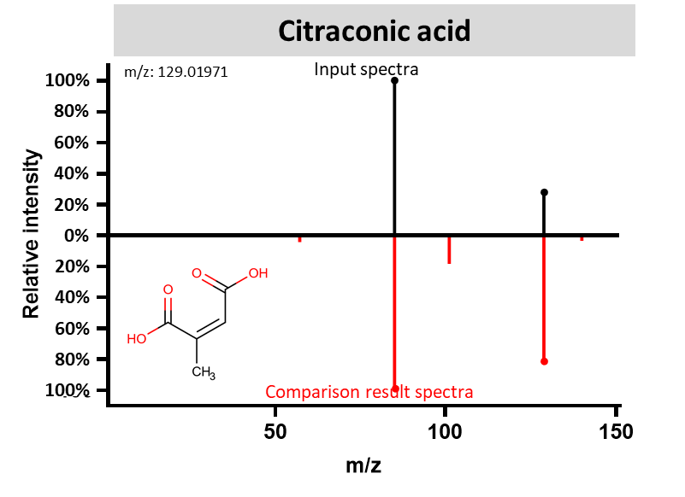
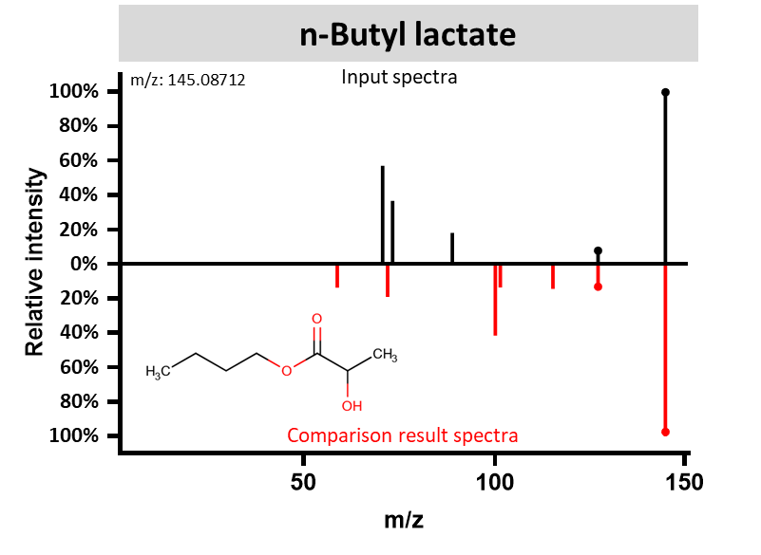
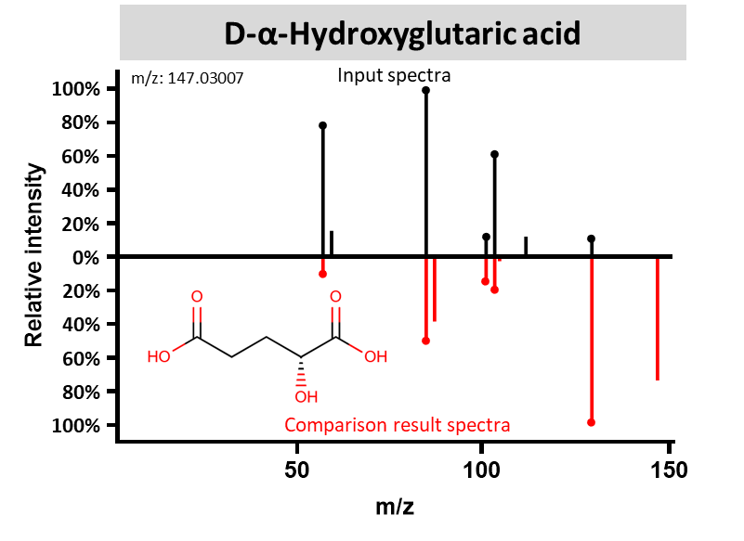
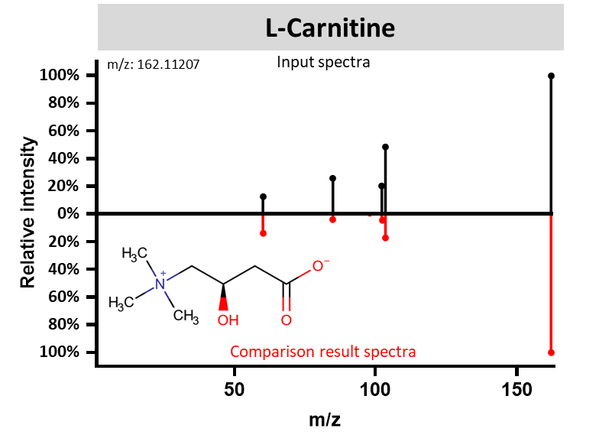
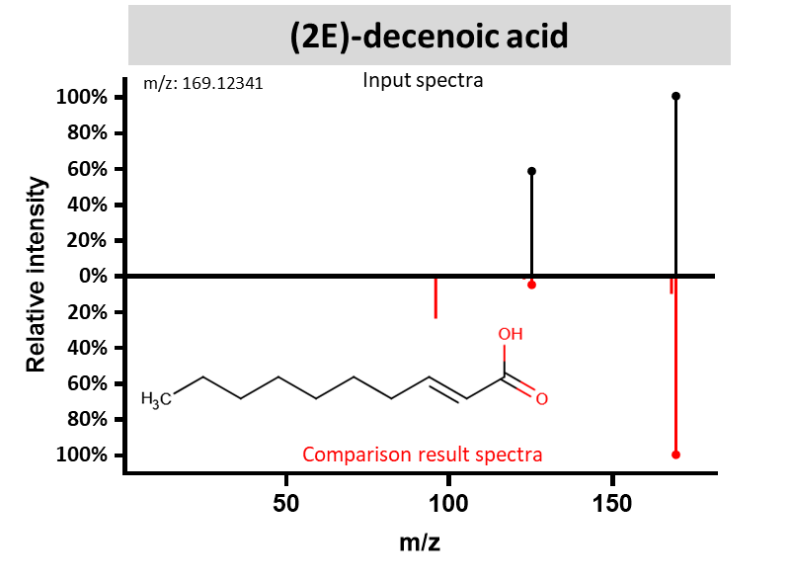
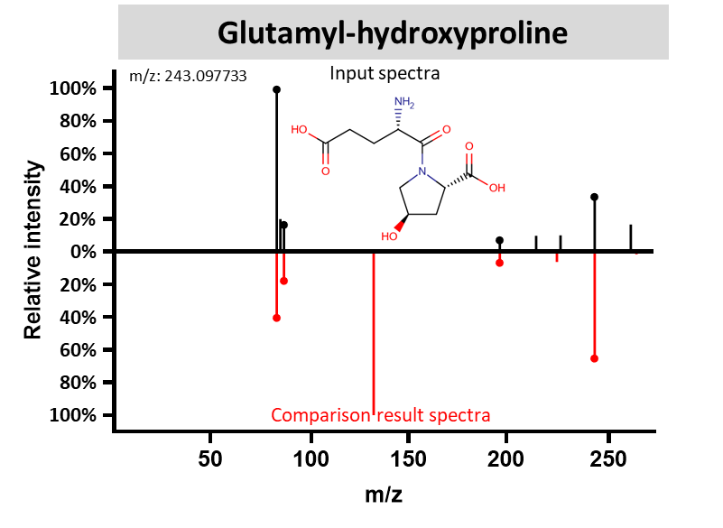
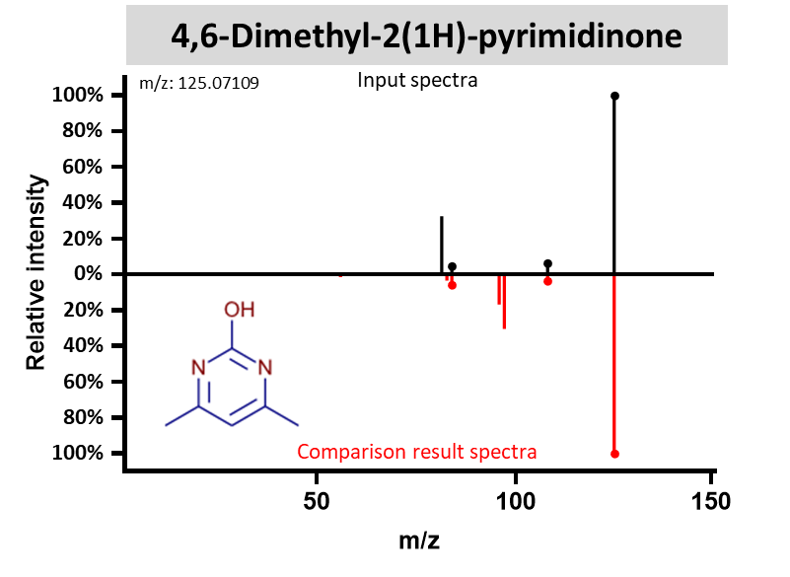
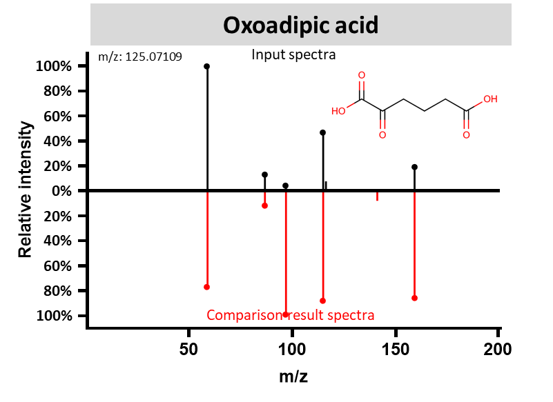
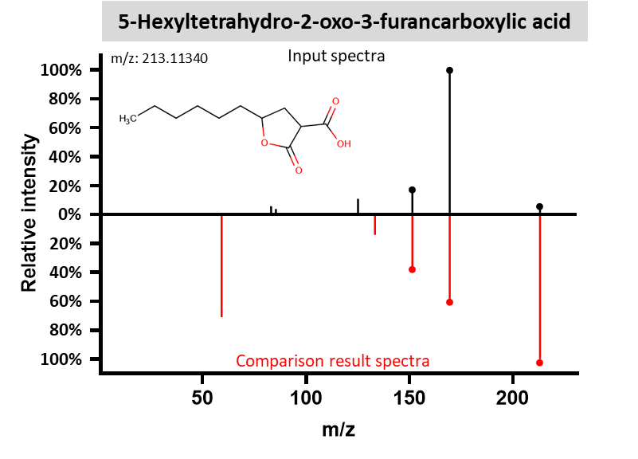
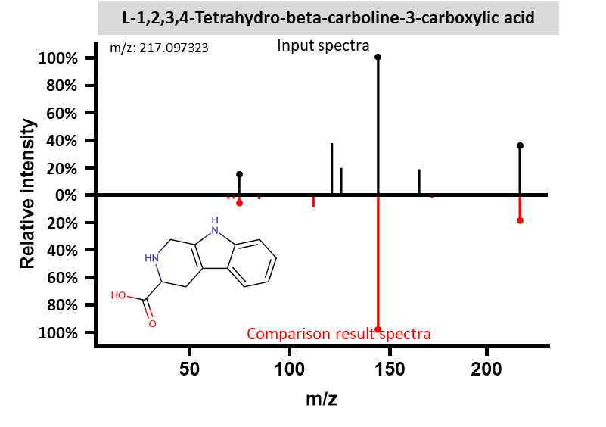
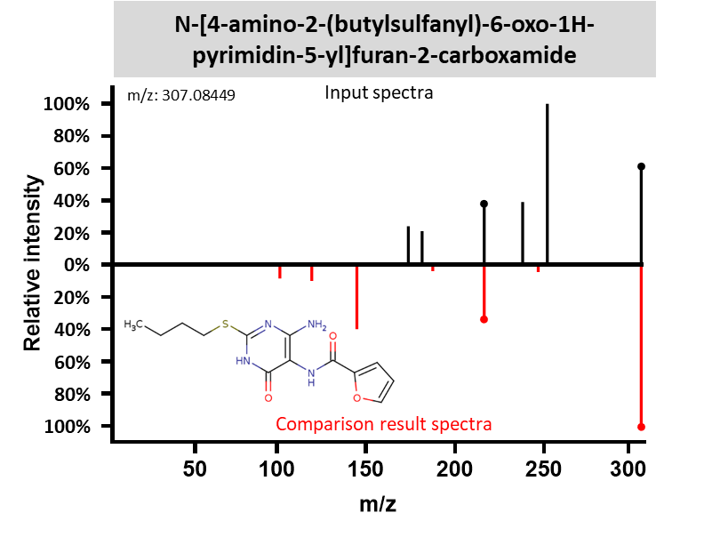

Slide 2
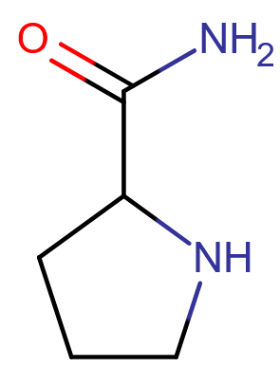
L-Prolinamide
m/z: 115.08674
Input spectra
100%
․
80%
60%
40%
․
20%
0%
20%
40%
․
60%
80%
․
100%
Comparison result spectra

Slide 3
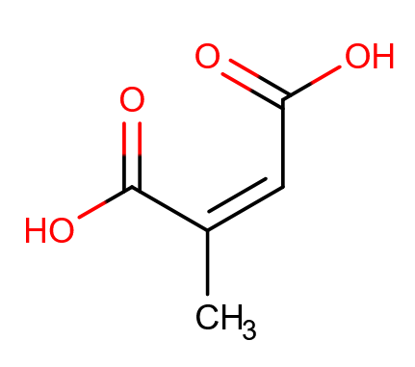
Citraconic acid
m/z: 129.01971
Input spectra
100%
․
80%
60%
40%
․
20%
0%
20%
40%
60%
80%
․
100%
․
Comparison result spectra

Slide 4
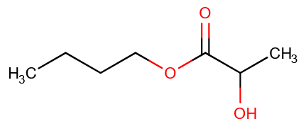
n-Butyl lactate
100%
m/z: 145.08712
Input spectra
․
80%
60%
40%
20%
․
0%
․
20%
40%
60%
80%
100%
Comparison result spectra
․

Slide 5
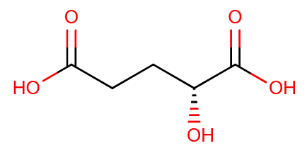
D-α-Hydroxyglutaric acid
m/z: 147.03007
Input spectra
100%
․
80%
․
60%
․
40%
20%
․
․
0%
․
․
20%
․
40%
․
60%
80%
100%
Comparison result spectra
․

Slide 6
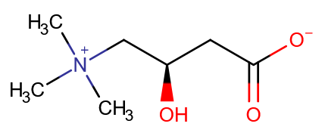
L-Carnitine
100%
m/z: 162.11207
Input spectra
․
80%
60%
․
40%
․
20%
․
․
0%
․
․
․
20%
․
40%
60%
80%
100%
Comparison result spectra
․

Slide 7
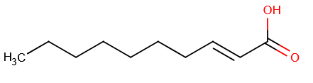
(2E)-decenoic acid
100%
m/z: 169.12341
Input spectra
․
80%
60%
․
40%
20%
0%
․
20%
40%
60%
80%
100%
Comparison result spectra
․

Slide 8
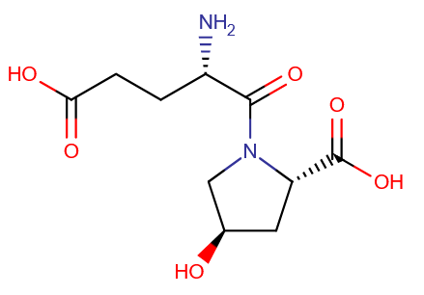
Glutamyl-hydroxyproline
100%
m/z: 243.097733
․
Input spectra
80%
60%
40%
․
20%
․
․
0%
․
20%
․
40%
․
60%
․
80%
100%
Comparison result spectra

Slide 9
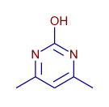
4,6-Dimethyl-2(1H)-pyrimidinone
100%
m/z: 125.07109
Input spectra
․
80%
60%
40%
20%
․
0%
․
․
․
20%
40%
60%
80%
100%
Comparison result spectra
․

Slide 10
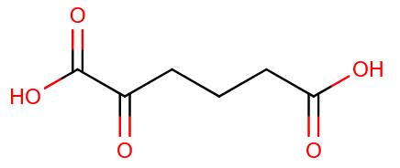
Oxoadipic acid
100%
m/z: 125.07109
․
Input spectra
80%
60%
․
40%
20%
․
․
0%
․
20%
․
40%
60%
80%
․
․
․
․
100%
Comparison result spectra

Slide 11
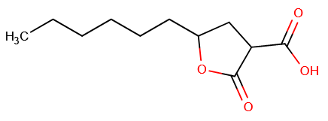
5-Hexyltetrahydro-2-oxo-3-furancarboxylic acid
100%
m/z: 213.11340
Input spectra
․
80%
60%
40%
20%
․
․
0%
20%
40%
․
60%
․
80%
100%
Comparison result spectra
․

Slide 12
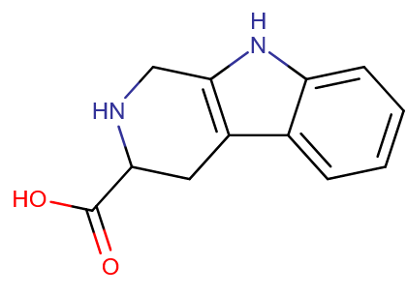
L-1,2,3,4-Tetrahydro-beta-carboline-3-carboxylic acid
m/z: 217.097323
Input spectra
100%
․
80%
60%
40%
․
20%
․
0%
․
20%
․
40%
60%
80%
100%
․
Comparison result spectra

Slide 13
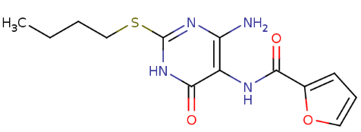
N-[4-amino-2-(butylsulfanyl)-6-oxo-1H-pyrimidin-5-yl]furan-2-carboxamide
100%
m/z: 307.08449
Input spectra
80%
60%
․
40%
․
20%
0%
20%
․
40%
60%
80%
100%
Comparison result spectra
․

